Slide 1

Stroke Prediction Using Machine Learning
This presentation delves into the development of a machine learning model for predicting stroke occurrence. We'll explore the process of data preprocessing, visualization, and model building to gain insights and create a reliable predictive tool.

Slide 2

Project Objective
Goal
Aim
To develop a machine learning model that accurately predicts stroke occurrence based on patient health data.
To analyze the dataset, identify patterns, and evaluate the performance of various models to find the most effective one for accurate predictions.

Slide 3
Project Overview
1
Milestone 1: Data Preparation
This stage involves data collection, cleaning, and preprocessing to ensure data quality and prepare it for analysis.
2
Milestone 2: Data Visualization
Visualizing the data helps uncover patterns, trends, and relationships between variables, providing insights into stroke prediction.
3
Milestone 3: Data Encoding
Categorical variables are transformed into numerical formats suitable for machine learning models.
4
Milestone 4: Machine Learning Models
Various machine learning models are trained and evaluated to identify the most accurate and reliable model for stroke prediction.

Slide 4

01) Data Preparation

Slide 5


Data Description
The “healthcare-dataset-stroke-data” is a stroke prediction dataset from Kaggle that contains 5110 observations (rows) with 12 attributes (columns). Each observation corresponds to one patient, and the attributes are variables about the health status of each patient. In particular, the categorical variables are id, gender, hypertension (yes/no), heart disease (yes/no), marital status, work type (children, government job, never worked, private, self-employer), residence type (urban, rural), smoking status (formerly smoked, never smoked, smokes), and stroke history. As for quantitative variables we have one’s age, BMI and average glucose leve

Slide 6
Dataset Characteristics
Attribute
Description
Age
Patient's age in years
Gender
Patient's gender (Male/Female)
Hypertension
Presence or absence of hypertension (0/1)
Heart Disease
Presence or absence of heart disease (0/1)
Work Type
Patient's work type (Private/Self-employed/Govt_job/children/Never_worked)
Avg Glucose Level
Patient's average glucose level
BMI
Patient's body mass index
Smoking Status
Patient's smoking status (formerly smoked/never smoked/smokes/Unknown)
Stroke
Target variable indicating stroke occurrence (0/1)

Slide 7
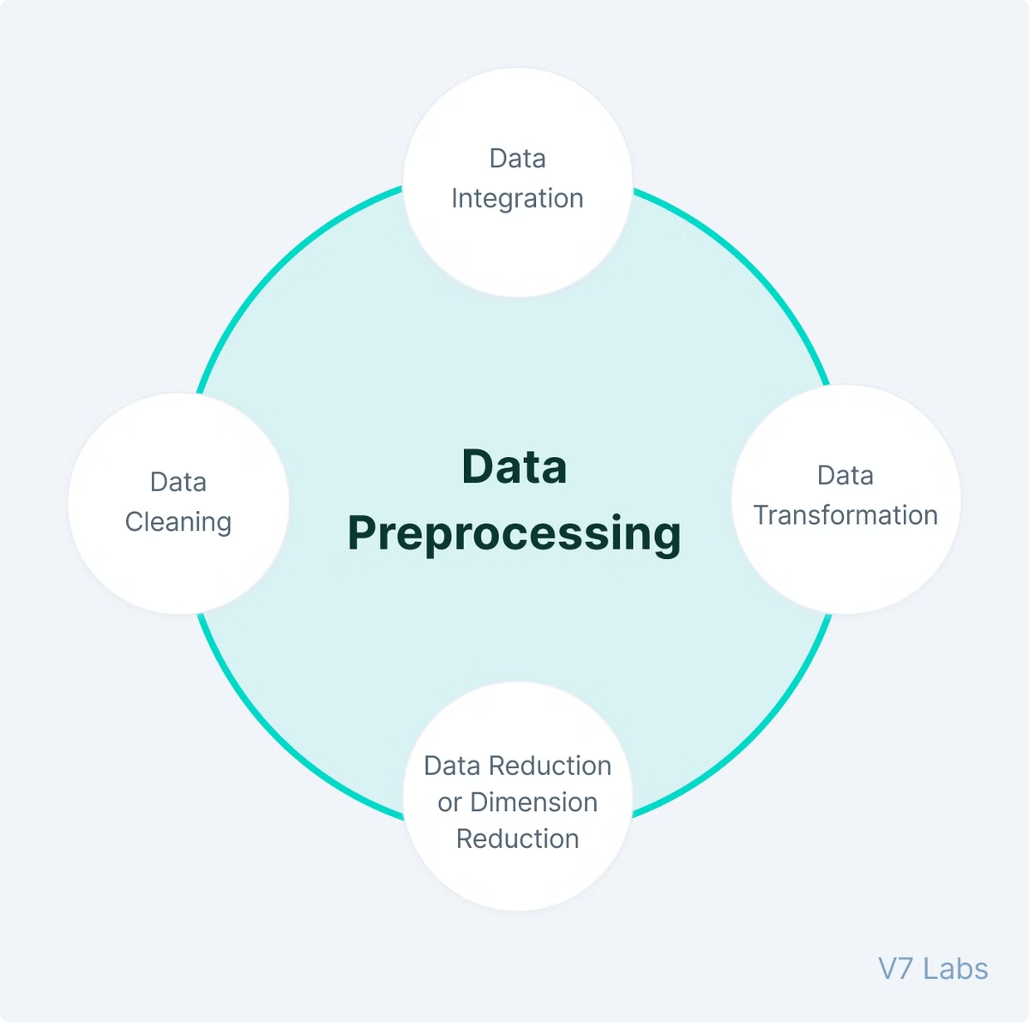
Preprocessing data
Data cleansing
Since the data includes NA values and unknown values, we did the following steps for data cleasing:
Remove data that contains “N/A”. (remove 201 from 5109)
Remove data with the gender of “Other”. (remove 1 from 5109)
Remove column “ID” that is meaningless for classification.

Slide 8

02 ) Data Visualization

Slide 9
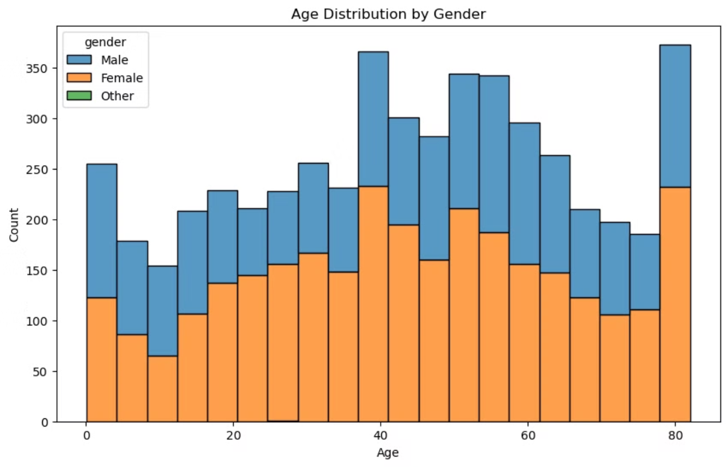
How does the distribution of age, gender look across patients?
Based on this Gender-Based Age Distribution plot we can say that we have little bit more of female data as compare to man. we have lot of data of people between the ages of 40 and 80.

Slide 10
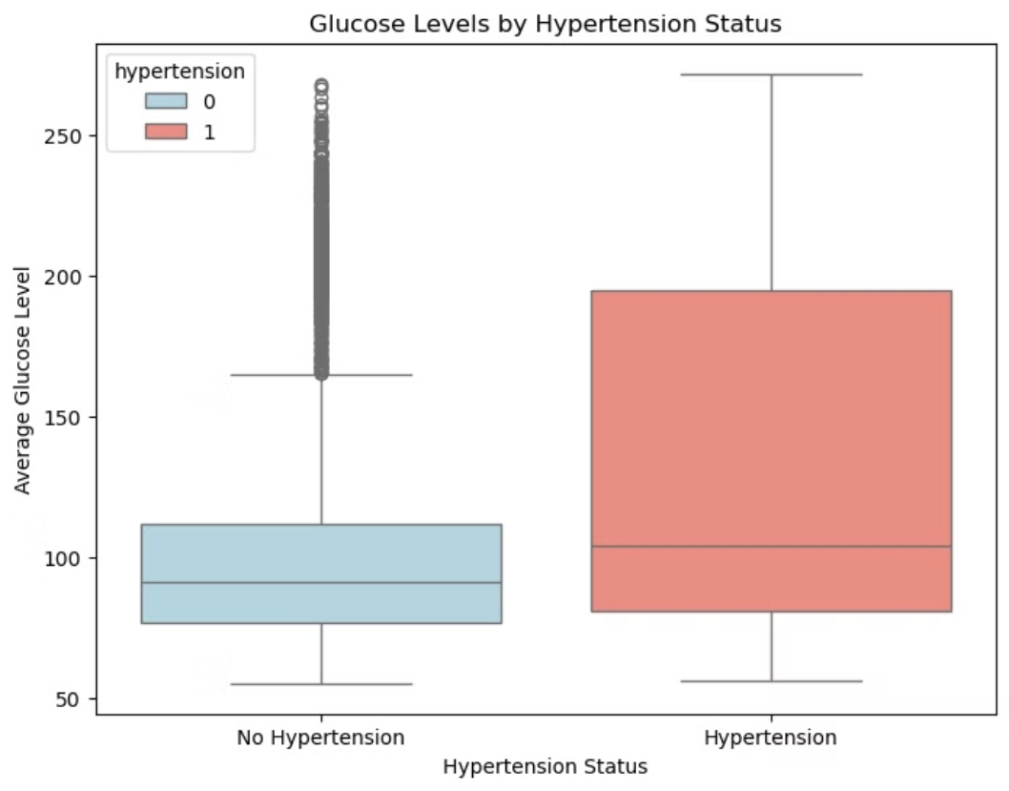
How does the average glucose level vary between individuals with and without hypertension?
This question can provide insights into the relationship between glucose levels and hypertension.
The analysis suggests a potential link between hypertension and higher average glucose levels. Individuals with hypertension tend to have not only higher but also more variable glucose levels.This could imply that hypertensive individuals are at an increased risk for elevated glucose levels, and they might benefit from regular monitoring and glucose management to prevent further health complications.

Slide 11
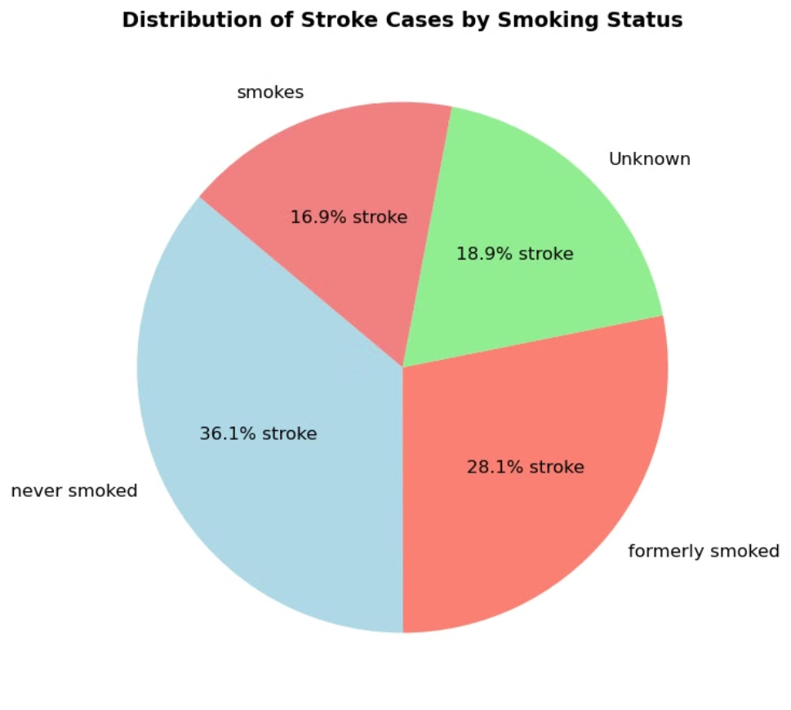
How does smoking status correlate with the incidence of stroke?
This question can help visualize the impact of smoking habits on stroke risk
While there is an observable presence of stroke cases among those who formerly smoked, current smokers surprisingly represent a smaller proportion. This analysis suggests that both former smokers and non-smokers have notable stroke risk factors, perhaps indicating that stroke risk may be influenced by a combination of lifestyle, medical history, and other health factors beyond smoking alone.

Slide 12
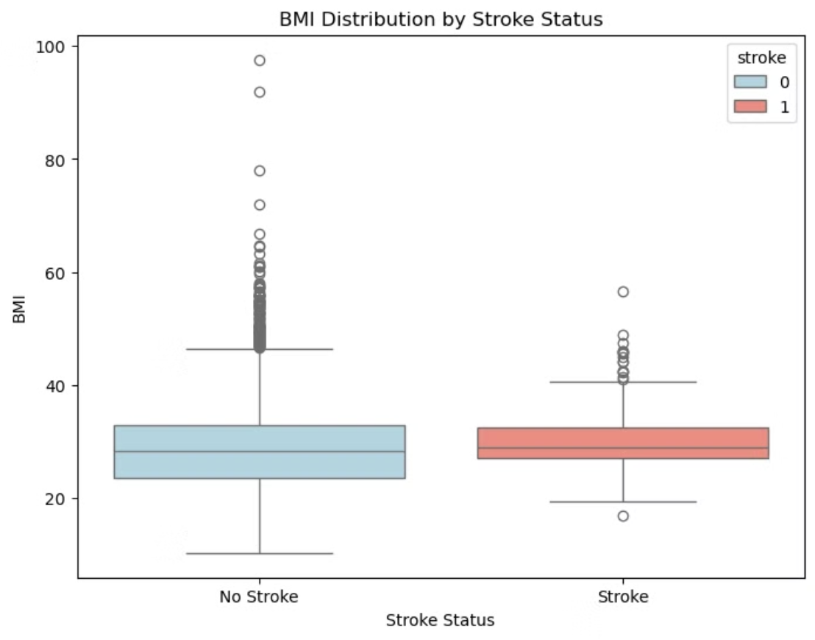
What is the relationship between BMI and stroke occurrences?
This question can help understand if BMI is a significant factor in stroke risk.
BMI and Stroke Relationship: Although individuals with a stroke have a slightly higher median BMI, the difference is not pronounced in this plot. This suggests that while BMI might have some association with stroke risk, it is not a sole indicator, as high BMI outliers are also present in the no-stroke group.

Slide 13
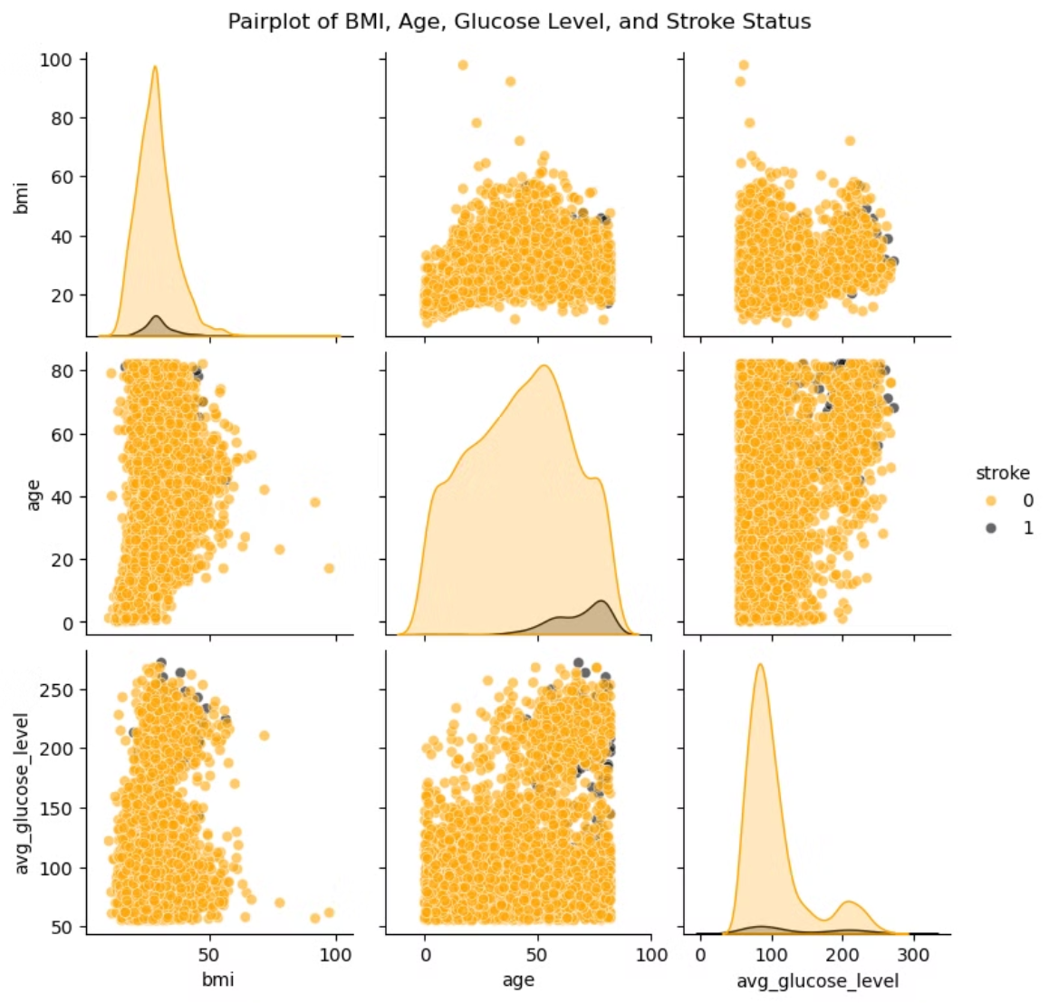
What is the relationship among BMI, age, avg_glucose_level, and stroke

Slide 14
Insights of pairplot
1
BMI vs. Stroke
2
Age vs. Stroke
The distribution of BMI is mostly similar for individuals with and without a stroke.
There is a noticeable increase in stroke occurrences with higher age values. Many stroke cases are clustered among older individuals, particularly those above 50.
There are some stroke cases among individuals with high BMI values, but the correlation is not very distinct.
Younger individuals (below 50) show fewer stroke cases, suggesting age could be a significant factor in stroke risk.
3
Average Glucose Level vs. Stroke
4
Relationship Between BMI, Age, and Glucose Level
Individuals with strokes tend to have a higher average glucose level, although there are also many high glucose levels among individuals without a stroke.
There isn’t a strong visible correlation between BMI and age or between BMI and average glucose level in terms of stroke occurrences.
This suggests that high glucose levels could be associated with a higher risk of stroke but might not be a definitive predictor on their own.
However, age and glucose level show a moderate association with stroke when examined independently.
Age and Glucose Level as Key Factors:Age and average glucose level appear to have a stronger association with stroke occurrences than BMI. Older age and higher glucose levels are more commonly observed among individuals who have had a stroke.
BMI’s Limited Impact: BMI alone does not show a clear trend or correlation with stroke, although there are stroke cases in higher BMI ranges.

Slide 15
03) Data Encoding

Slide 16


Why Encoding?
Encoding categorical variables into numerical formats is essential for machine learning algorithms, as they work best with numerical data. This process ensures compatibility, avoids misinterpretation of categories as ordinal, and eliminates redundancy or multicollinearity..
Impact:
This transformed dataset is entirely numeric, enabling efficient model training and better performance. The encoding ensures that no category is implicitly prioritized and maintains the interpretability of the features.

Slide 17
let's Encode !
Binary Encoding:
Encoded 'Residence_type' as 1 (Urban) and 0 (Rural) for simplicity.
Converted 'ever_married' to binary: 1 for 'Yes' and 0 for 'No’.
One-Hot Encoding:
Transformed 'gender,' 'work_type,' and 'smoking_status' into multiple binary columns for each unique category.
Examples: 'gender_Male,' 'work_type_Private,' and 'smoking_status_never_smoked'.
Work Type Encoding: Mapped each category (e.g., 'Private,' 'Self-employed') into individual binary columns.
Gender Encoding: Created separate binary columns for 'Male' and 'Female'.
Smoking Status Encoding: Added binary columns for 'formerly smoked,' 'never smoked,' 'smokes,' and 'Unknown.'
Created a new dataset by dropping the original categorical columns

Slide 18

04 ) Model Training and Evaluation

Slide 19
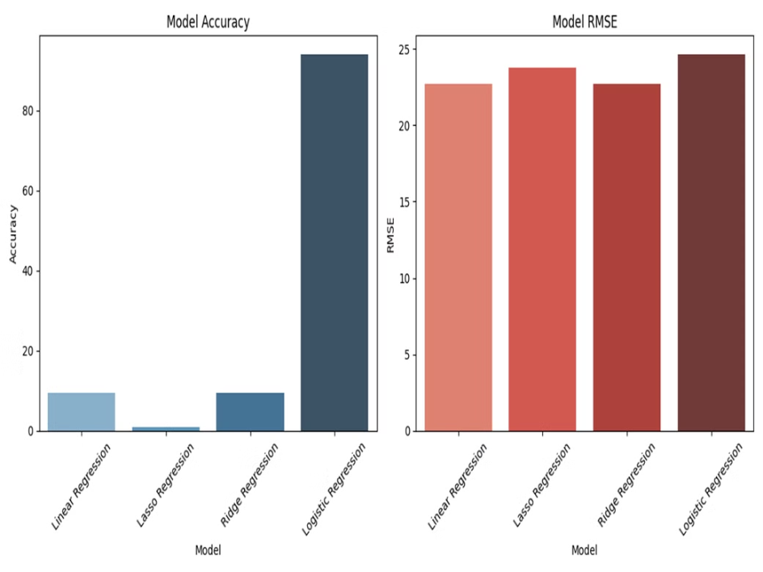
Model Performance Summary: RMSE and Accuracy
Model
Accuracy
RSME
Linear Regression
9.10%
22.76%
Lasso Regression
0.94%
23.76%
Ridge Regression
9.10%
22.76%
Logistic Regression
93.93%
24.63%

Slide 20
Model Performance Evaluation
RMSE
Accuracy
Precision, Recall, F1 Score
Linear and Ridge models have the lowest RMSE, indicating the most accurate predictions, while Lasso has slightly higher errors, and Logistic Regression performs the worst with the highest RMSE.
•Accuracy: 93.93% The accuracy score is quite high, but it can be misleading in imbalanced datasets. High accuracy can occur if the model correctly predicts the majority class (no stroke) but fails to identify the minority class (stroke). Given that the dataset is likely imbalanced, this accuracy should be interpreted carefully.
•Precision: 0.50 Precision is the ratio of correctly predicted positive observations to the total predicted positives. A precision of 0.50 means that 50% of all the cases predicted as stroke actually have a stroke. This is decent, but it could be better.
•Recall: 0.02 Recall is the ratio of correctly predicted positive observations to the all observations in actual class. A recall of 0.02 means that only 2% of the actual stroke cases are correctly identified by the model. This indicates a poor performance in identifying stroke cases, which is critical for this prediction task.
•F1 Score: 0.03 F1 Score is the weighted average of Precision and Recall. With a value of 0.03, the model struggles to balance precision and recall, meaning it fails to both correctly predict stroke cases (low recall) and predict strokes with certainty (moderate precision).

Slide 21

Final Insights
The dataset's class imbalance, with a significant majority of "No Stroke" cases, poses a challenge for model performance. While high accuracy is achieved, the models struggle to accurately detect stroke cases. Metrics like recall and F1-score are more reliable than accuracy for evaluating minority class detection. The project highlights the importance of data preprocessing, visualization, and model selection in developing accurate and reliable predictive models for healthcare applications.

Slide 22
THANK YOU

